Slide 1
Designing a Kubernetes Operator for Machine Learning Applications
Jibeom Kim
Notes:
Hello, my name is Ji-beom Kim. I’m in the master’s course in professor jeong’s lab.
The paper to be presented is titled Designing a Kubernetes Operator for Machine Learning Applications.

Slide 2
Paper information
Abstract
Introduction
Background
Design of Kuberay
The Internals of KubeRay
Experimental Results
Related work
Conclusions
Notes:
Contents is as follows: Paper information, Abstract, Introduction, Background, Design of Kuberay, The Internals of KubeRay, Experimental Results, Related work, finally there is a conclusions.

Slide 3
Paper information
Designing a Kubernetes Operator for Machine Learning Applications
Authors: Ali Kanso, Edi Palencia, Kinshuman Patra, Jiaxin Shan, Mengyuan Chao, Xu wei, Tengwei Cai, Kang Chen, Shuai Qiao
Published in: WoC '21: Proceedings of the Seventh International Workshop on Container Technologies and Container Clouds December 2021
Publisher: ACM (Association for Computing Machinery)
Notes:
This is the paper information. It is a paper written by Ali Kanso. and was published in WoC ‘21 and Publisher is ACM.
As a reference, I am currently working on Operator in the lab. I am considering whether to conduct a framework-related Operator research.
So I prepared a presentation.

Slide 4
Abstract
Machine Learning workloads such as deep learning and hyperparameter tuning are compute-intensive by nature.
Parallel execution is key to reducing the learning time.
The Ray Framework is a distributed middleware that provides primitives to seamlessly parallelize machine learning code execution across a cluster of compute node.
Kubernetes, the container management middleware, satisfies all the requirements to create and scale ray clusters.

Slide 5
Abstract
However, setting up a cluster within Kubernetes, is a tedious and error prone task when done manually.
In this paper authors present KubeRay, an Operator and suite of tools designed, and built to create Ray cluster in Kubernetes with minimum effort.
Authors present our architectural choices, our open- source implementation, and authors analyze the performance of our solution.
Notes:
As a reference, we are currently working on providing disaster recovery services in the lab.
This solution is similar in direction to our research in that it pursues services with the goal of business continuity during disaster recovery, so we prepared a presentation.

Slide 6
Introduction
Having a single compute-instance (physical machine, virtual machine (VM) or a container) handle all the computation is not a feasible approach.
Especially that some model training can last days or weeks.
The classic solution for this problem is parallelization.
Authors can significantly reduce the compute time by splitting the application code into smaller tasks that can be scheduled on different compute-instances and collect their computational results.

Slide 7
Introduction
The Ray framework [2] is built specifically to target the above issues. It is developed for building distributed applications, allowing developers to leverage simple Ray APIs to make their code clustering enabled.
A Ray cluster can be deployed on any compute-instance, such as a VM or a container. In this article authors argue that Ray is best deployed in containers and managed by Kubernetes [4], mainly for the following reasons.

Slide 8
Introduction
Containers can scale easily and fast. we will show in our experimental results, it takes less than 5 seconds to add a new container compute-instance.
Containers can easily be ported from one environment to another.
The Kubernetes API on Microsoft Azure AKS [5], Amazon EKS [6], or Google GKE [7] is always the same. Therefore, a single Ray cluster can be replicated in multiple environments, or it can span across clouds.

Slide 9
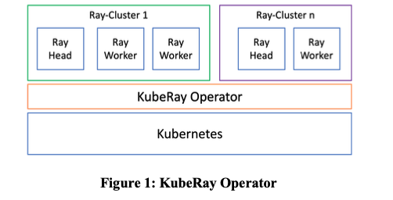
Introduction
Data- scientists developing ML applications lack the necessary Kubernetes expertise to setup a Ray cluster on Kubernetes and monitor, debug, and operate their applications running in such environment.
Notes:
Figure 1 shows the structure of the application of the TubeRay Operator. KubeRay Operator, which operates on Kubernetes, manages Ray-clusters.

Slide 10
Introduction
In this paper authors introduce the KubeRay Kubernetes Operator [8].
As a result, the operator maintains the Ray cluster with minimum intervention from the application developers.

Slide 11
Background
There are two modes of using the Ray framework.
Either one Ray cluster can host multiple applications, or each machine learning application can be encapsulated in its own Ray cluster, and hence multiple Ray clusters can co-exist in the same compute environment (such a Kubernetes cluster).
Authors believe the latter case is the most prevalent when offering machine learning as a service on Kubernetes.
Notes:
In this Section I will present more details on the Ray framework and Kubernetes.

Slide 12
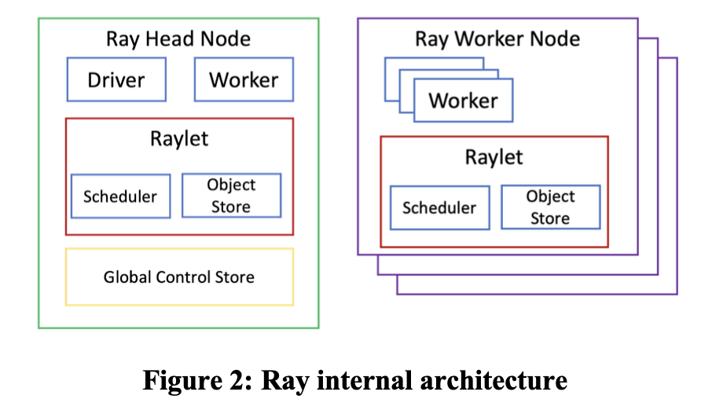
Background-Ray Architecture
The head node manages the metadata that can be accessed by other nodes in the cluster such as the directory for locating objects.
The driver is the root python process for the application and workers which are python processes that can execute tasks.
Notes:
Ray defines the notion of a head node and worker nodes as shown in Figure 2.

Slide 13
Background-Ray Architecture
Each node has a Raylet containing a scheduler that manages resources and an object store that handles memory and state.
The worker nodes are identical to the head node without the global control store and the driver.

Slide 14
Background-Ray Architecture
A Ray node is a compute-instance that has the Ray components running inside.
A Ray worker is a process (within a Ray node) that is assigned tasks to execute by the scheduler.
Large objects are stored in the object store (which acts like shared storage across nodes), A worker can find a large objects by consulting the global control store.
Each worker node (compute-instance) can have different resources (CPU, GPU, Memory, Disk).
The Ray scheduler takes the available resources into consideration when scheduling the tasks.
Notes:
It is important here to distinguish between a Ray node, and a Ray worker.

Slide 15
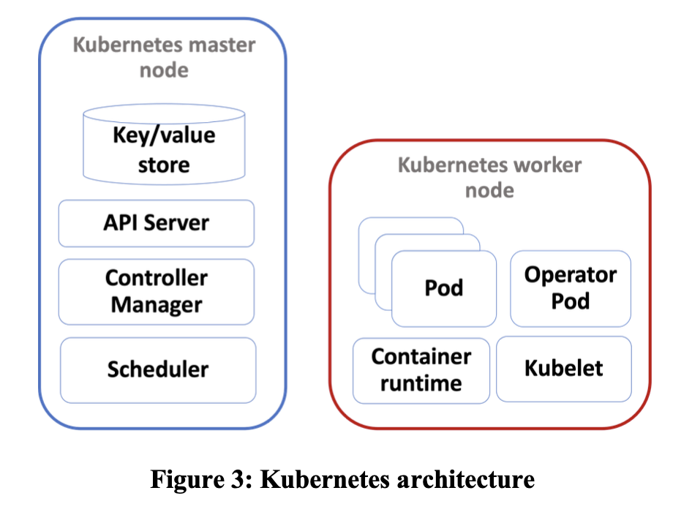
Background-Kubernetes
Kubernetes defines a declarative model for specifying a desired system state and implements a controller logic that constantly strives to reconcile the actual system state with the desired state.
The Kubernetes API-server serves REST operations and provides the frontend to the cluster's shared state.
Notes:
Figure 3 shows the structure of Kubernetes. I'll explain Kubernetes briefly.

Slide 16
Background-Kubernetes
Pods are the smallest deployable units of computing that you can create and manage in Kubernetes.
The controller manager in Kubernetes supports dozens of controllers (such as the deployment and replicaset controllers).

Slide 17
Background-Kubernetes Operator
Kubernetes supports the notion of custom resources.
A custom resource is an extension of the Kubernetes API.
Operators are software extensions to Kubernetes that make use ofcustom resources to manage applications and their components.

Slide 18
Background-Kubernetes Operator
Added security by managing through Role Based Access Control (RBAC) who has permissions to create/modify/delete Ray clusters on the K8s cluster.
Ability to enforce admission control on the Ray cluster configuration.
Ability to enforce resource quota in the namespace of the Ray cluster.
Leveraging the ubiquitous availability of Kubernetes as a service offering by cloud vendors. And as a result, allowing the Operator to manage a Ray cluster using kube-federation [10] across clusters.
Notes:
Operators inherit major benefits by being closely integrated with Kubernetes.

Slide 19
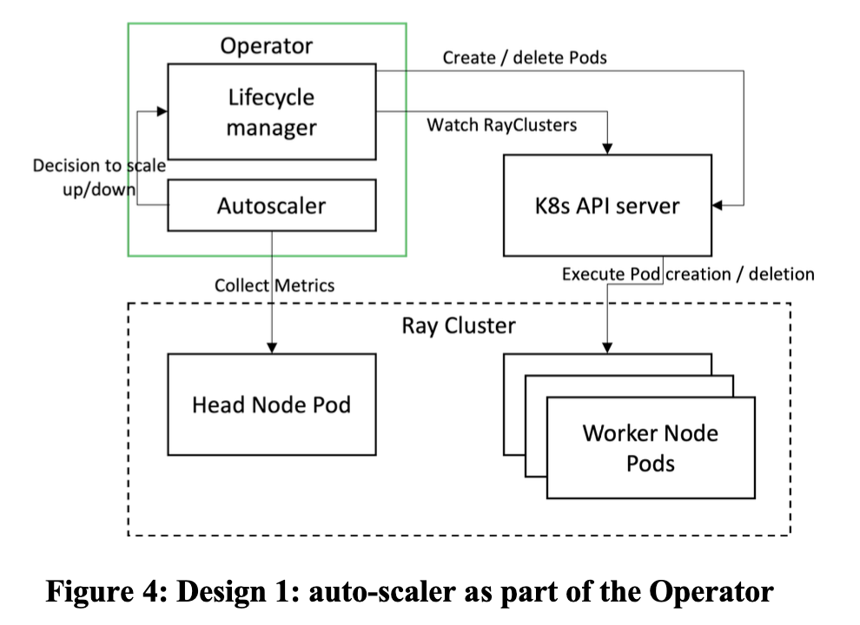
Design of Kuberay -Design 1: Operator with Auto-scaling Ability
The first design alternative is to embed the auto-scaling in the operator itself. This mixes concerns, having the same code base for the auto-scaler and lifecycle management.
Notes:
The authors compare the pros and cons of the three designs.

Slide 20
Design of Kuberay -Design 1: Operator with Auto-scaling Ability
Pros:
Faster communication between the auto-scaler and the lifecycle manager.
Cons:
• Mixing of concerns. By having the auto-scaler as part of the Operator, authors introduce tight coupling between the scaling and lifecycle management. Hence, if a novel auto-scaler with smarter (or domain specific algorithms) is to be used for the scaling decisions, then the entire Operator needs to be changed. Authors believe that this design pattern is not aligned the Kubernetes design principle of extensibility.

Slide 21
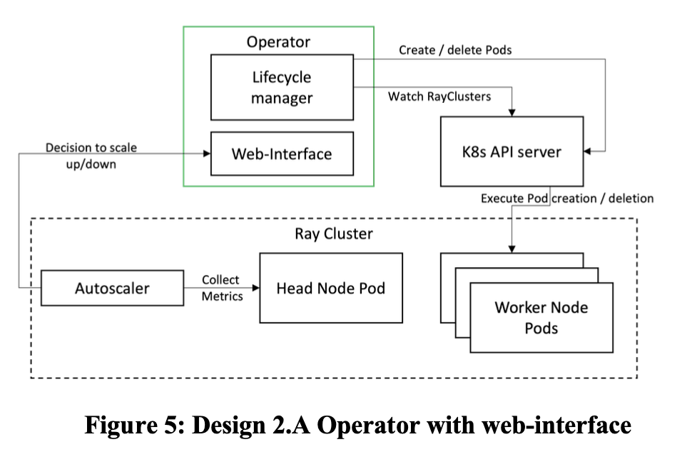
Design of Kuberay -Design 2.A: Operator Exposing web- interface
In this design, Authors extract the auto-scaling logic out of the operator, and instead, the Operator exposes a web-interface (HTTP/GRPC) through which the auto-scaling decisions are conveyed to the lifecycle manager.

Slide 22
Design of Kuberay -Design 2.A: Operator Exposing web- interface
Pros:
Relatively faster communication between the auto-scaler and the lifecycle manager.
Cons:
• A complicated logic is needed to enforce authentication and authorization between the auto-scaler and the Operator. This logic is already implemented in the Kubernetes API-server. And hence, authors lack the justification of this added complexity.

Slide 23
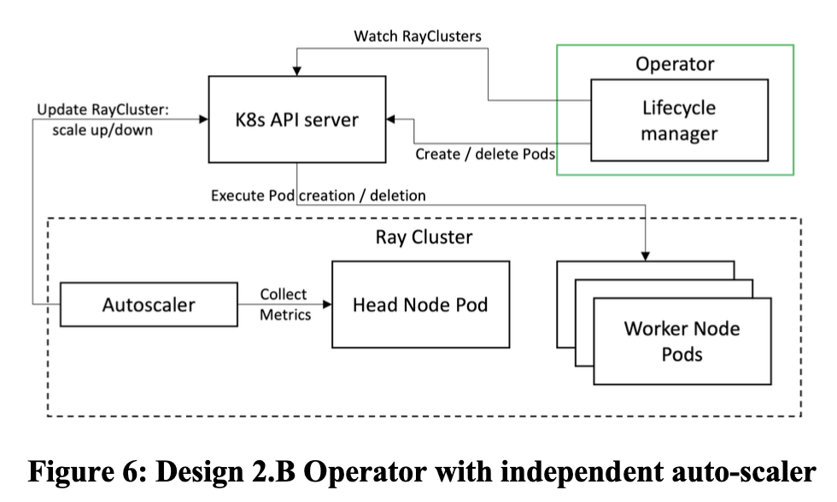
Design of Kuberay -Design 2.B: Operator without Auto-scaling Ability
In this design, authors have complete separation between the auto-scaler and the lifecycle manager.
The auto-scaler modifies the custom resource representing the Ray cluster in Kubernetes, and this triggers an event in the Operator watching for those changes to take the appropriate actions and reconcile the actual state with the desired state.

Slide 24
Design of Kuberay -Design 2.B: Operator without Auto-scaling Ability
Pros:
• Complete separation of concerns between the auto-scaler and the lifecycle manager.
Cons:
• Indirect communication between the auto-scaler and the lifecycle manager.
• See in the experimental results section, this indirect communication while it brings lots of value it incurs a latency of roughly 600 milliseconds.

Slide 25
The Internals of KubeRay
KubeRay reacts to the creation/deletion/modification of Kubernetes custom resources of type raycluster. Typically, a raycluster custom resource is created by the user, and it corresponds to an instance of a machine learning application.

Slide 26
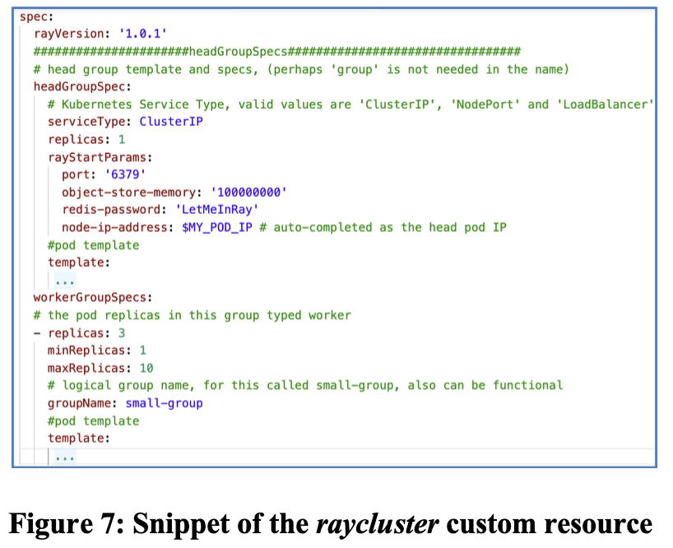
The Internals of KubeRay
The raycluster includes (among others) the service type used to abstract the head pod, the Ray start parameters, as well as the information for one or many worker groups.
The default Kubernetes Pod template is used to describe the pods to ensure a consistent Kubernetes user experience when using the Operator.
Notes:
Figure 7 presents a snippet of the raycluster custom resource.
/
One thing to note here, is that many parameters are calculated at runtime and embedded by the operator into the pods show in next slide.

Slide 27
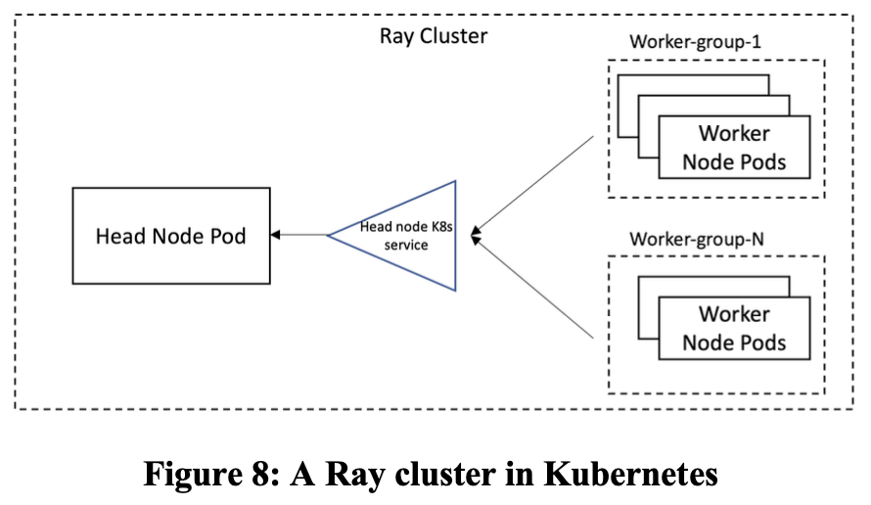
The Internals of KubeRay
KubeRay parses each raycluster custom resource instance and starts by creating the head pod. It assigns the head pod labels and environment variables. It also uses Kubernetes downward API [12] to set as environment variable the pod’s IP address and ports.

Slide 28
The Internals of KubeRay
This information is set to be consumed by the machine learning application using the Ray library inside the head pod. Kuberay also mounts an emptyDir volume to the shared memory mount point /dev/shm to be used by the Ray object store.

Slide 29
The Internals of KubeRay
Once the head pod is created KubeRay creates a Kubernetes with the proper selectors to abstract the head pod. This is mainly to ensure that even if the head pod fails and is recreated with a new IP address, the workers can still connect/reconnect using the service IP address stored in the Kubernetes DNS server.

Slide 30
The Internals of KubeRay
Next, KubeRay generates a configuration for an init-container that is injected in the Ray worker pods. The init-container is container that runs until a condition is met and then exists allowing the main container of the Pod to start. KubeRay injects a script in our init- container that periodically checks if the DNS lookup for the head service yields in a valid result (signaling that the head pod has been assigned a valid IP).

Slide 31
The Internals of KubeRay
This avoids workers trying to connect to an unavailable head and crashing. KubeRay sets up the proper parameters for the “ray start” command in the workers to make sure they can reach the head and the correct flag values including Redis authentication.
Notes:
/
After the Ray cluster is up, it can be scaled up by increasing the number workers (in the raycluster custom resource instance) for a given worker group or creating a new worker group all together.
As for scaling down, the scaling strategy field supports defining pods by name to remove a specific node.
Otherwise, if the any worker can be removed, then we can simply decrement the number of workers.

Slide 32
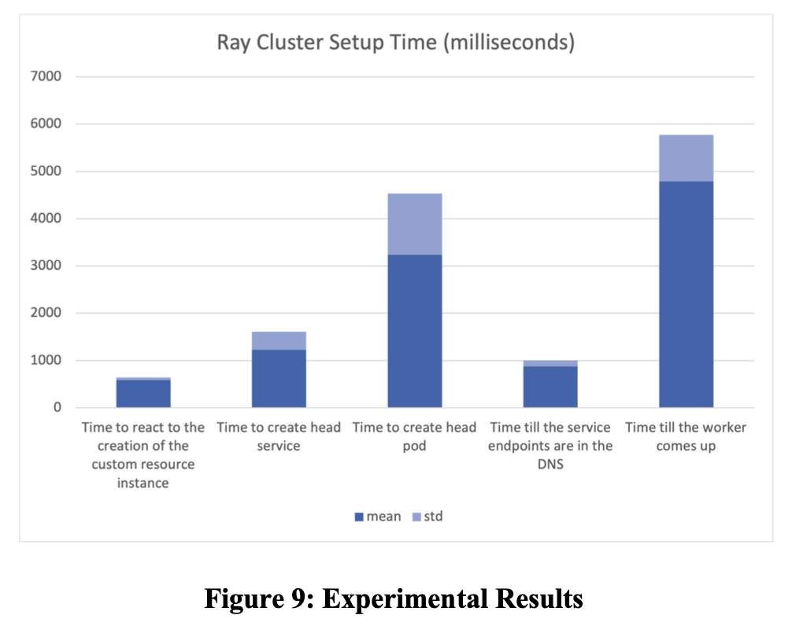
Experimental Results
Authors tested KubeRay on an Azure cluster of three virtual machines each with 64 cores Intel(R) Xeon(R) Platinum 8272CL CPU @ 2.60GHz, with 256 GB or RAM and 10Gbit/s Ethernet interface.
The experimental results are the average of 50 experiments running a basic Python Ray application that creates 100 tasks to print the Ray worker node names.

Slide 33
Experimental Results
KubeRay follows a specific sequence for creating a Ray cluster, starting with the head service, then the head Pod, and finally the worker Pods.
The primary reason for this order is that if the head Pod creation fails, there is no need to proceed with creating the workers.
However, this does not imply that the workers are created only after the head is fully operational.
Instead, once Kubernetes accepts the head Pod definition, KubeRay submits the worker Pod definitions for creation.

Slide 34
Experimental Results
The time it takes for a Ray worker to be up and running is considered the total cluster setup time, which is approximately 5 seconds.
This duration accounts for the successful creation of both the head Pod and head service.
From the moment a user creates a raycluster custom resource instance in Kubernetes to the time KubeRay receives the request, the process takes less than 600 milliseconds.
This timeframe includes Kubernetes authentication, authorization, validation, persisting the raycluster instance, and sending the notification event to KubeRay.

Slide 35
Experimental Results
An interesting observation is that the average 5-second setup time for the Ray cluster aligns with Kubernetes' service level objective (SLO) for the startup latency of schedulable stateless pods.
Excluding the time required to pull images and run init-containers, this latency should be less than 5 seconds, as measured from pod creation to when all its containers are reported as started and observed via watch.
This alignment between the Ray cluster setup time and Kubernetes SLO indicates that KubeRay efficiently manages Ray clusters within the Kubernetes ecosystem.

Slide 36
Related Work-Ray Autoscaler
Mixed concerns for scaling and lifecycle management: The Ray Autoscaler has been observed to mix concerns between scaling and lifecycle management, which can lead to confusion and inefficiencies. Instead, mature tools like Terraform or cloud provider APIs are preferred for handling these tasks.
Non-intuitive API: The Ray Autoscaler's API is not as user-friendly as it could be, making it difficult to describe pods without using the Pod-Template. This can lead to confusion and inefficient usage of resources.
Insufficient testing for production use: The Ray Autoscaler has not undergone the rigorous testing needed to be considered production-ready. This is partly due to its implementation in Python, which has limited Kubernetes testing support. Golang, on the other hand, provides in-memory Kubernetes API-servers for testing, making it a more suitable language for developing Kubernetes-related tools.
Notes:
KubeRay is a solution developed in response to the limitations of the Ray Autoscaler for scaling Ray clusters in Kubernetes.
The main reasons for opting out of using the Ray Autoscaler and creating KubeRay instead are as follows:
Based on these reasons, KubeRay was developed as a more suitable and production-ready alternative to the Ray Autoscaler.
In collaboration with Ray developers, KubeRay addresses the concerns and limitations mentioned above, providing a more reliable and user-friendly solution for scaling Ray clusters in Kubernetes.

Slide 37
Related Work-Kubeflow
Kubeflow is an open-source framework that provides a set of tools for deploying and managing machine learning workflows on Kubernetes.
It enables users to declaratively specify the sequence of creating Kubernetes objects, which makes it easier to automate and standardize the deployment process.
However, as you mentioned, Kubeflow has limitations when it comes to extracting information from each step and using it in the next step in an imperative way. This can make it more difficult to customize workflows and optimize performance.

Slide 38
Related Work-Kubeflow
KubeRay is designed to handle these challenges and enable users to react to failures, scale requests, and manage the lifecycle of the cluster more effectively.
KubeRay is an imperative framework that uses code to specify the sequence of events and handle failures and other issues that arise during the deployment process.
This approach can be more powerful and flexible than Kubeflow's declarative approach, but it also requires more effort and expertise to implement.
Overall, both Kubeflow and KubeRay have their strengths and weaknesses, and the choice between them depends on the specific needs and constraints of the project at hand.

Slide 39
Conclusions
In this paper authors presented KubeRay, a Kubernetes Operator for managing distributed machine learning applications running on the Ray framework.
Authors presented different design alternatives and discussed the advantages and shortcomings of each design.
Authors then discussed the internals of KubeRay and showed our experimental results showing that KubeRay is a viable solution for managing Ray clusters in Kubernetes.
The KubeRay Operator distinguishes itself from previous research by utilizing KubeRay to manage machine learning applications in Kubernetes environments, including cluster lifecycle management, and automating environment setup.

Slide 40
Conclusions
However, the experimental results presented in the paper only show the benefits of automation through the Operator, while Kubeflow, which is widely used, is only described with its disadvantages and compared by stating that "both Kubeflow and KubeRay have their strengths and weaknesses, and the choice between them depends on the specific needs and constraints of the project."
Therefore, I think there is a need for objective criteria that have not developed an Operator for Kubeflow.
However, this paper sufficiently demonstrates the need for research that automates configuration and manages the scale, lifecycle, and other aspects of clusters through Operators for other frameworks.

Slide 41
References
[1] Thang Le Duc, Rafael García Leiva, Paolo Casari, and Per-Olov Östberg. 2019. Machine Learning Methods for Reliable Resource Provisioning in Edge-Cloud Computing: A Survey. ACM Comput. Surv. 52, 5, Article 94 (October 2019), 39 pages. DOI:https://doi.org/10.1145/3341145
[2] The Ray Framework. URL: https://www.ray.io/ last accessed in October 2021
[3] Ray Remote Functions URL: https://docs.ray.io/en/latest/walkthrough.html last accessed in October 2021
[4] Kubernetes: The Container Management Framework. URL: https://kubernetes.io/ last accessed in October 2021.
[5] Azure Kubernetes Service. URL: https://azure.microsoft.com/enus/services/kubernetes-service/#overview last accessed in October 2021
[6] AWS Kubernetes Service. URL: https://aws.amazon.com/eks/ last accessed in October 2021.
[7] Google Kubernetes Engine. URL: https://cloud.google.com/kubernetes-engine last accessed in October 2021.
[8] KubeRay: The Ray Kubernetes Operator. URL: https://github.com/rayproject/kuberay/tree/master/ray-operator last accessed in October 2021
[9] The Kubernetes Operator Design Pattern. URL: https://kubernetes.io/docs/concepts/extend-kubernetes/operator/ last accessed in October 2021
[10] Kubernetes Cluster Federation. URL: https://github.com/kubernetessigs/kubefed last accessed in October 2021.
[11] KubeRay design document, URL: https://docs.google.com/document/d/1DPSe34DkqQ4AeJpoBnSrUM8SnHnQVkiLlcmI4zWEWg/edit#heading=h.uvghkc1tgnfw, last accessed on October 2021.
[12] Kubernetes Downward API. URL: https://kubernetes.io/docs/tasks/inject-dataapplication/downward-api-volume-expose-pod-information/ last accessed in October 2021.

Slide 42
References
[13] Kubernetes Service Level Objective / Service Level Indicator SLO/SLI https://github.com/kubernetes/community/blob/master/sigscalability/slos/slos.md last accessed in October 2021.
[14] KubeFlow https://www.kubeflow.org/ last accessed in October 2021.
[15] Amazon Sagemaker URL: https://aws.amazon.com/pm/sagemaker/ last accessed in October 2021.
[16] Run:AI https://www.run.ai/ last accessed in October 2021.
[17] L. Toka, G. Dobreff, B. Fodor and B. Sonkoly, "Machine Learning-Based Scaling Management for Kubernetes Edge Clusters," in IEEE Transactions on Network and Service Management, vol. 18, no. 1, pp. 958-972, March 2021, doi: 10.1109/TNSM.2021.3052837.
[18] Chun-Hsiang Lee, Zhaofeng Li, Xu Lu, Tiyun Chen, Saisai Yang, and Chao Wu. 2020. Multi-Tenant Machine Learning Platform Based on Kubernetes. In Proceedings of the 2020 6th International Conference on Computing and Artificial Intelligence (ICCAI '20). Association for Computing Machinery, NewYork, NY, USA, 5–12. DOI:https://doi.org/10.1145/3404555.3404565
[19] Yuzhou Huang, Kaiyu cai, Ran Zong, and Yugang Mao. 2019. Design and implementation of an edge computing platform architecture using Docker and Kubernetes for machine learning. In Proceedings of the 3rd International Conference on High Performance Compilation, Computing and Communications (HP3C '19). Association for Computing Machinery, New York, NY, USA, 29–32. DOI:https://doi.org/10.1145/3318265.3318288
[20] AnyScale. URL: https://www.anyscale.com/ last accessed in October 2021.
[21] ByteDance. URL: https://www.bytedance.com/en/ last accessed in October 2021.
[22] AntGroup. URL: https://www.antgroup.com/en last accessed in October 2021.
[23] Ray Autoscaler Kubernetes-plugin URL: https://github.com/rayproject/ray/tree/ray-1.7.0/python/ray/autoscaler last accessed in October 2021.

Slide 43
Notes:
The Kubernetes Api server is watching the current state of the custom resource, and if it differs from the desired state, the Operator is executed.
The operator always maintains the desired state.

